Slide 1
Solar and Lunar Eclipse Milestone Report
Rachel Raikar
Mentor: Jan Zikes

Slide 2
Project Outline
Problem Definition
Study the frequency of occurrence of eclipses and determine which eclipses are more common.
Study the correlation between time of year and occurrence of eclipses.
Client Base and Motivation
Astronomers to statistically confirm their theories about the occurrences of eclipses.
Data Overview
Acquired from NASA public dataset domain.
Two separate CSV files with data pertaining to solar and lunar eclipses respectively.

Slide 3
Preliminary Solution Outline
Data exploration and cleansing
Study distributions of months when eclipses occur.
Analyze the data visually and statistically.
Explain findings and practical significance of results.

Slide 4
Data Wrangling
Imported CSV files as PANDAS dataframes and reindexed the rows with the column ‘Catalog number’.
Filtered the data frames to contain only relevant columns:
Solar Eclipses Data Frame
'Calendar Date', 'Eclipse Time', 'Delta T (s)', 'Eclipse Type','Eclipse Magnitude', 'Latitude', 'Longitude', 'Sun Altitude', 'Sun Azimuth', 'Path Width (km)', 'Central Duration'
Lunar Eclipses Data Frame
'Calendar Date', 'Eclipse Time', 'Delta T (s)','Eclipse Type', 'Latitude', 'Longitude', 'Penumbral Eclipse Duration (m)', 'Partial Eclipse Duration (m)','Total Eclipse Duration (m)'

Slide 5
Reorganized data by calendar date in Chronological order
Converted the dates into a list of [year, month, day] for easier analysis of trends.
Note: The years have negative values because the data is during the five millennium period -1999 to +3000 (2000 BCE to 3000 CE).
Missing values appearing as ‘-’ were replaced with NAN values.
No outlier data found.

Slide 6
Data Story
Which type of eclipse is more common?
There seem to be 166 more lunar eclipses than solar eclipses over a 5000 year period
How many solar/lunar eclipses per year on average?
Solar: ~2.3796/yr
Lunar: ~2.4128/yr
Approximately equal - the difference of 166 is only due to the large size of the data.

Slide 7
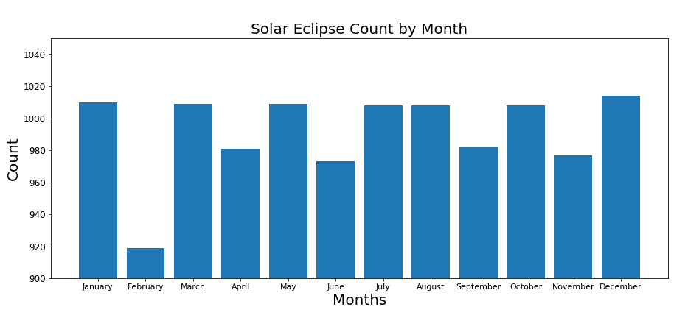
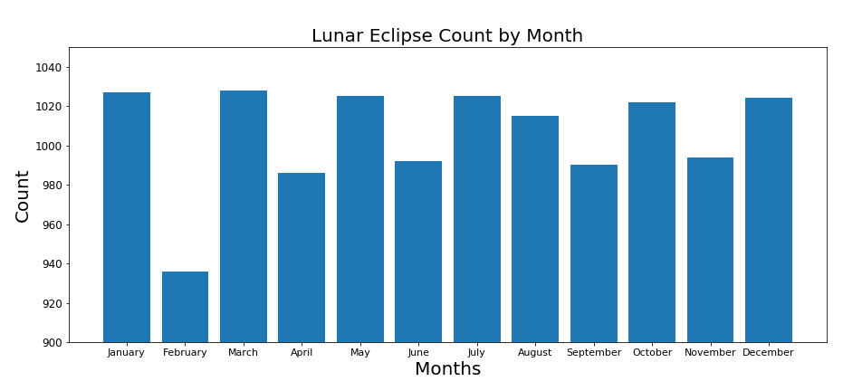
Is there a trend in eclipses vs. month?
Solar and lunar eclipses seem to have relatively the same trend with every month
The slight variation in frequency is due to lengths of the months

Slide 8
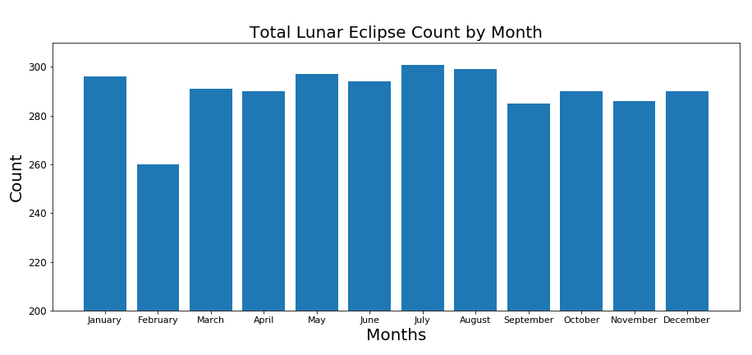
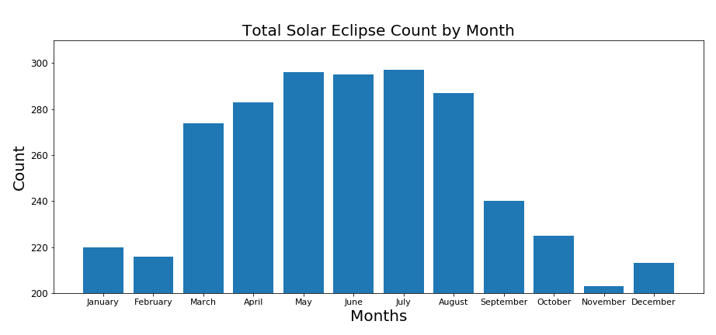
Trends in Total Eclipses
Total solar eclipses seem to veer off this trend greatly. They seem to be more common during the second half of the year during the seasons Fall and Winter (September - January).

Slide 9
Statistical Analysis
Group 1: September - February (Fall - Winter according to US seasons)
Group 2: March - August (Spring - Summer according to US season)
HYPOTHESIS TEST
To test the hypothesis that total eclipse is not directly correlated to the months in the year
𝐻𝑜 : The probability of total eclipse occurring is the same for Group 1 and Group 2. (𝑝1=𝑝2)
𝐻𝑎 : The probability of total eclipse occurring is not the same for Group 1 and Group 2. (𝑝1≠𝑝2)

Slide 10
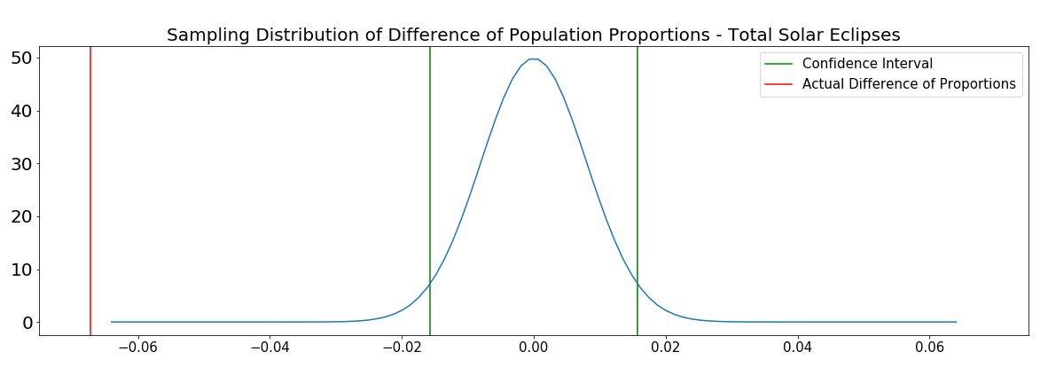
Statistical Analysis of Total Solar Eclipse
Confidence Interval: [-0.01568 0.01568]
Observed Difference: -0.06719

Slide 11
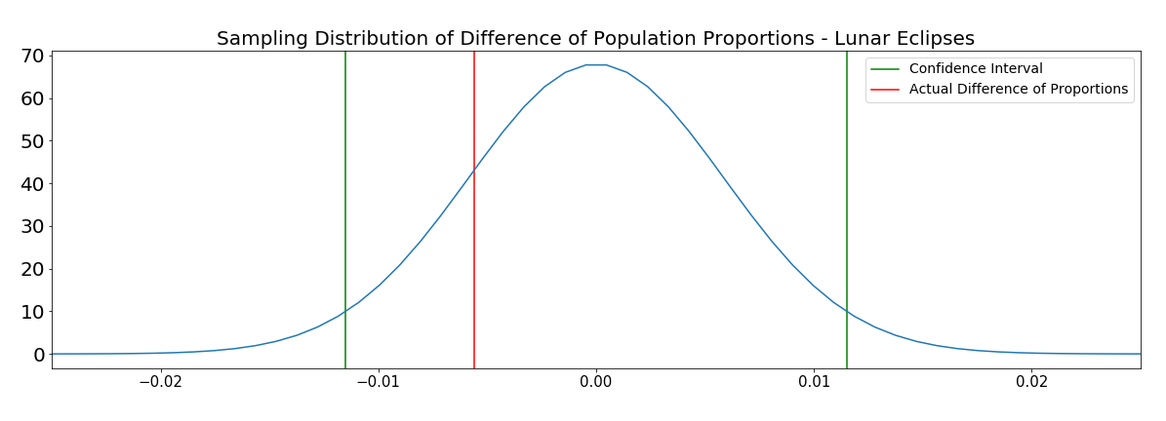
Statistical Analysis of Total Lunar Eclipse
Confidence Interval: [-0.01149 0.01149]
Observed Difference: -0.00560

